Slide 1
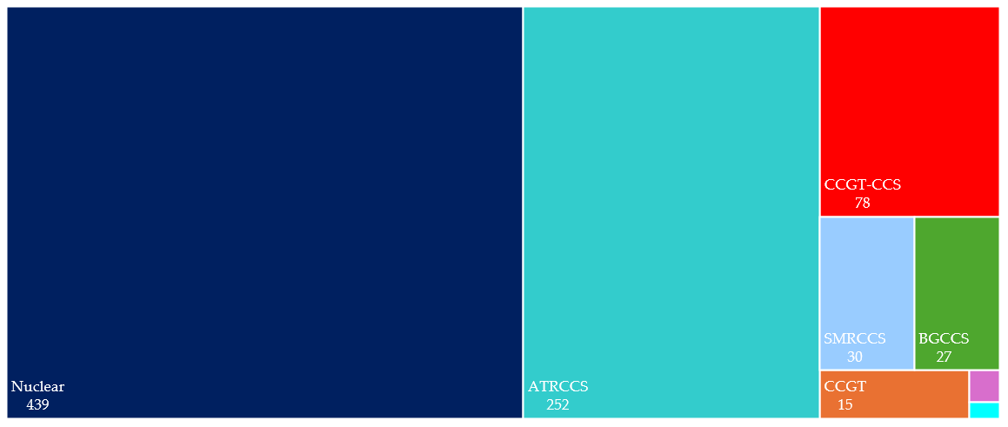
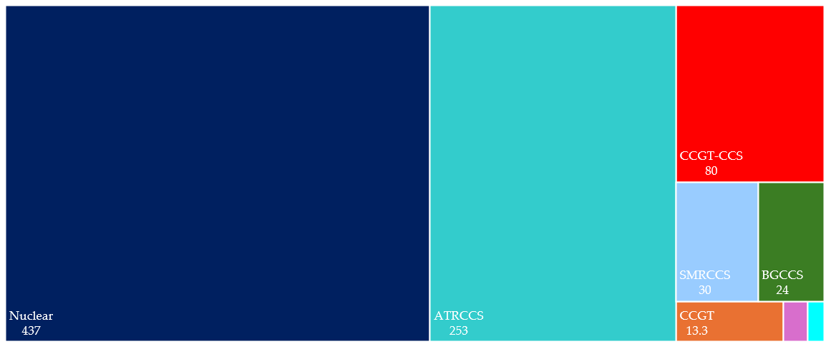
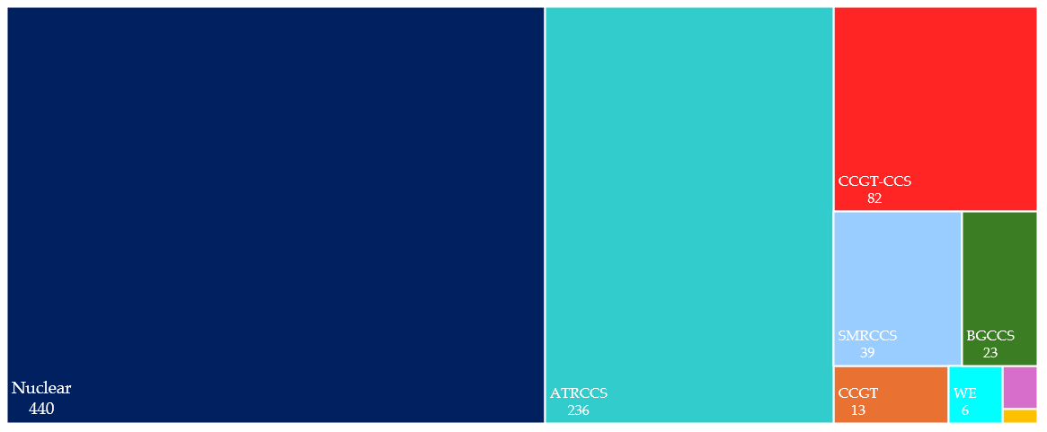
(a)
3
WE
2
3
H2CCGT
(b)
3
H2CCGT
1
BECCS
(c)
3
H2CCGT
1
WE

